Slide 1
Sprouting Readers through STEM!!!!
Presented by:
Mrs. Diane Chen-Kelly
Ms. Lakisha Brinson
Dr. Regina Etter

Slide 2
Hattie Cotton STEM Magnet Elementary School

Slide 3
Our Motto:
Where the best BECOME better!
Notes:
WE say: in STEM (Science, Technology, Engineering, Math)

Slide 4
READ, READ, READ

Slide 5
Sprouting Readers through STEM!!!!
Notes:
Diane will share the reading connection to STEM: how you came up with the title

Slide 6
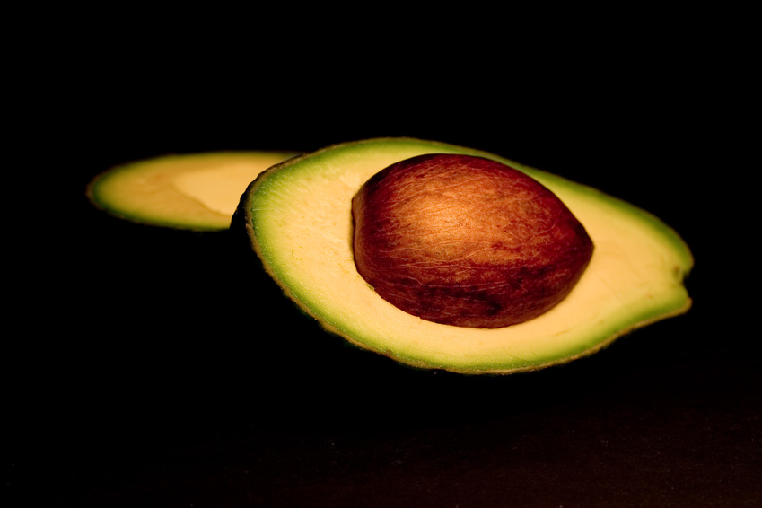
Notes:
Starts with a seed

Slide 7
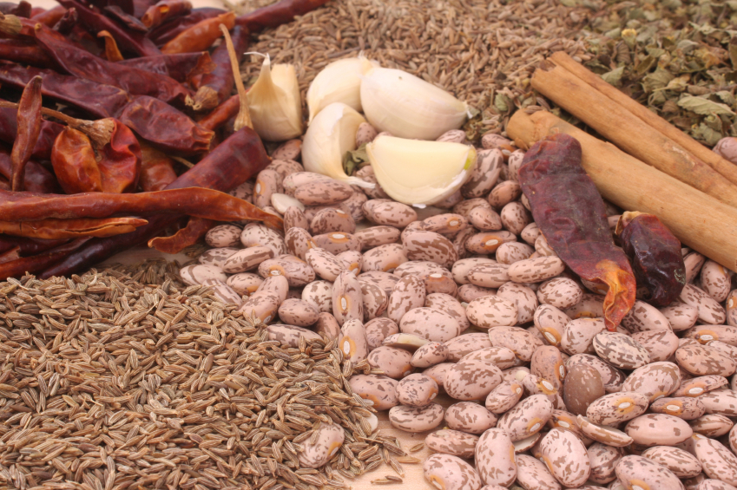
Notes:
We sow many seeds

Slide 8
Systemic Reforms
Differentiated Learning
Inquiry-based Learning
Project Based Learning
Curriculum Development
Engineering is Elementary
Understanding by Design
Balanced Literacy
Cooperative Learning
The 5 E’s
Notes:
Brinson: Systemic Reforms; part on grant

Slide 9
Web Resources
www.practicallyparadise.org
http://hcstem.weebly.com/

Slide 10
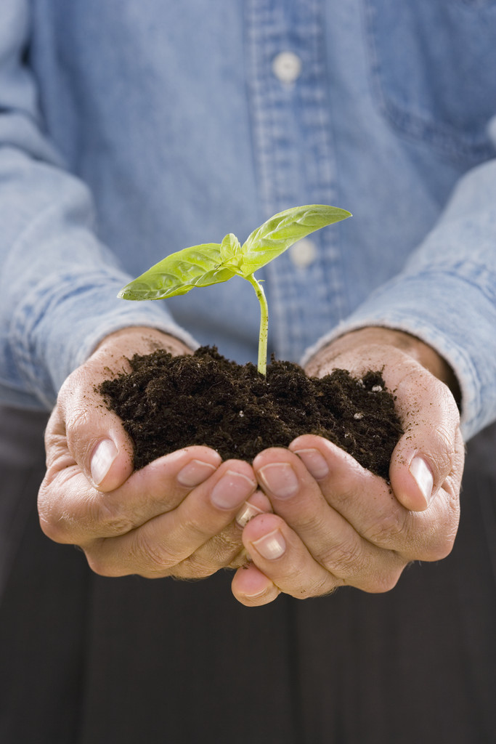
Creating the climate
Notes:
STEM instructors cultivate the soil which is the climate; with hands-on experiences (buy-in)

Slide 11
Seeds of Inquiry Based Instruction
Structured Inquiry- the facilitator gives participants a hands-on problem to investigate, and the methods and materials to use for the investigation but not the expected outcomes.
Guided Inquiry- The facilitator gives participants only the problem to investigate and the materials to use for the investigation.
Open Inquiry- Participants determine the questions to investigate, procedures to address their questions, date to generate and what the data means.
Notes:
Brinson: 3 types of inquiry
We bring the seeds to life

Slide 12
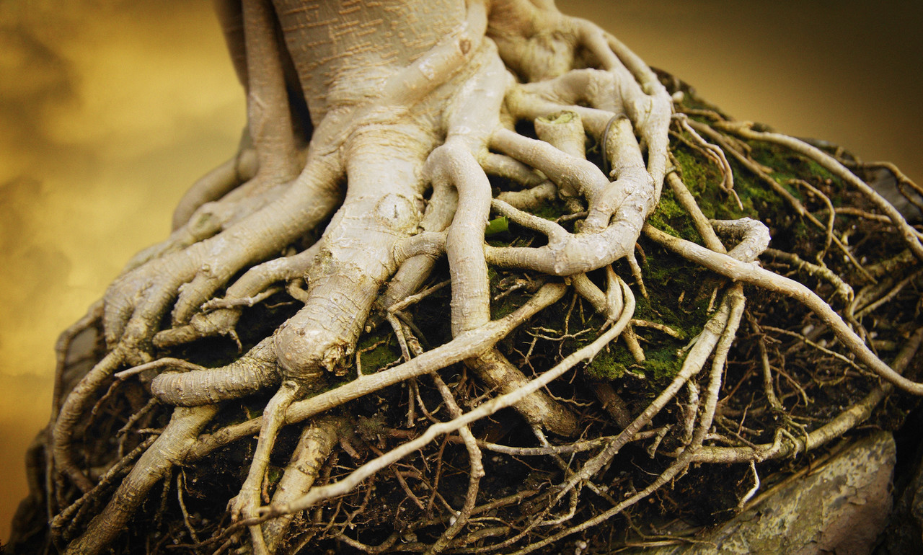
ROOTS
Notes:
CCSS (Common Core State Standards) Next Generation Science Standards

Slide 13
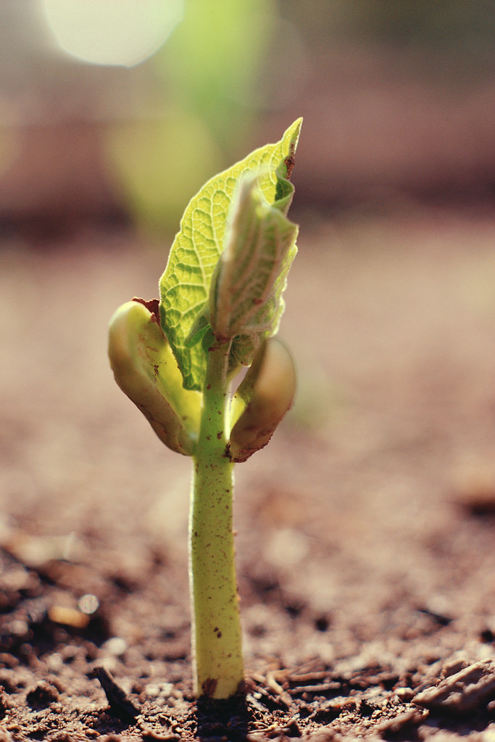
Sprouts
Notes:
PBL- 8 essential elements
Entry Event; project Overview

Slide 14
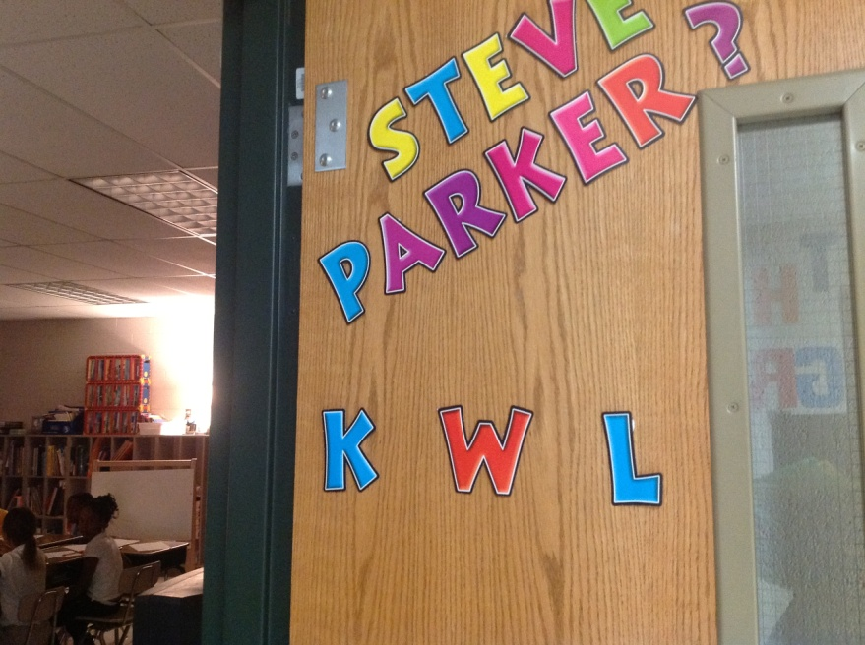
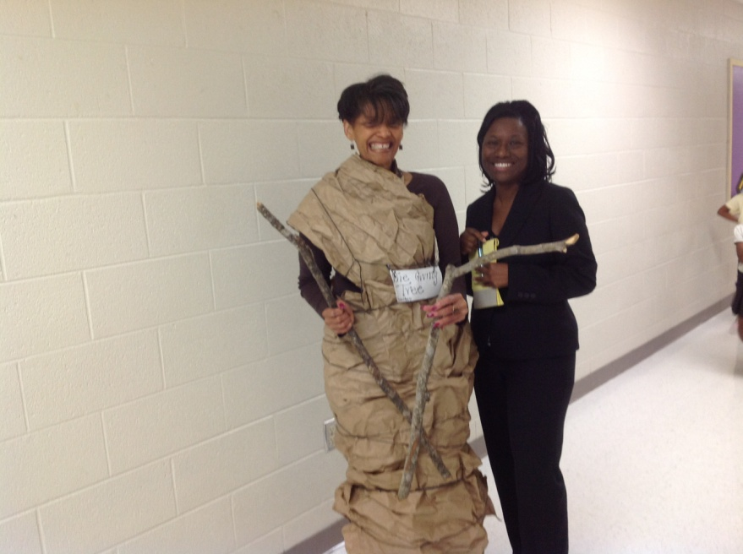
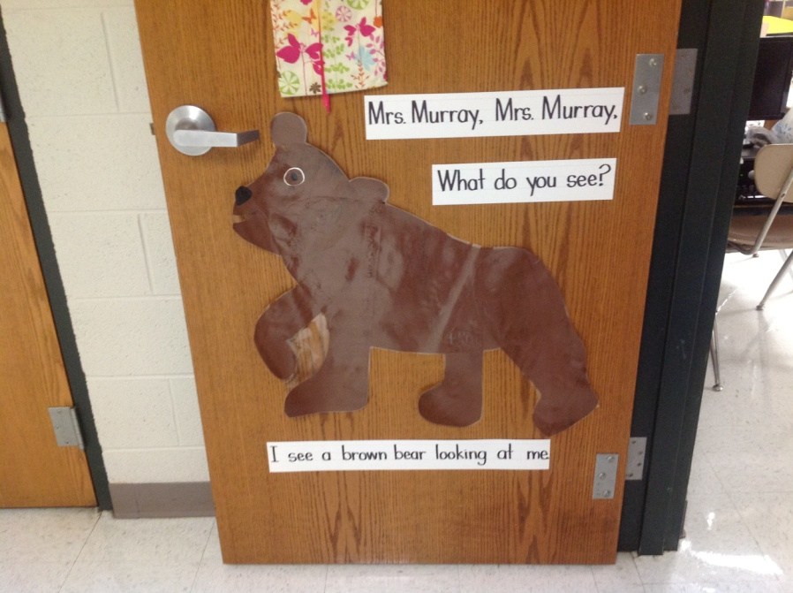
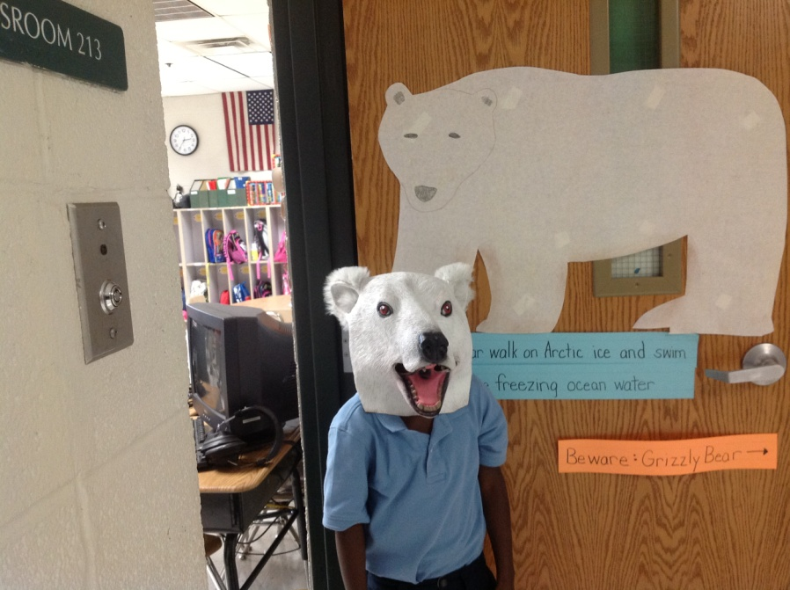

Slide 15
Stem
Notes:
The pathway to learning; What teachers are doing (constructivism)
Information: Vanderbilt Scientist, Reading Clinic, Science Museum, Mentors

Slide 16
Leaves
Notes:
The processing: EiE kits, Scientific Method, Science Kits, Engineering process

Slide 17
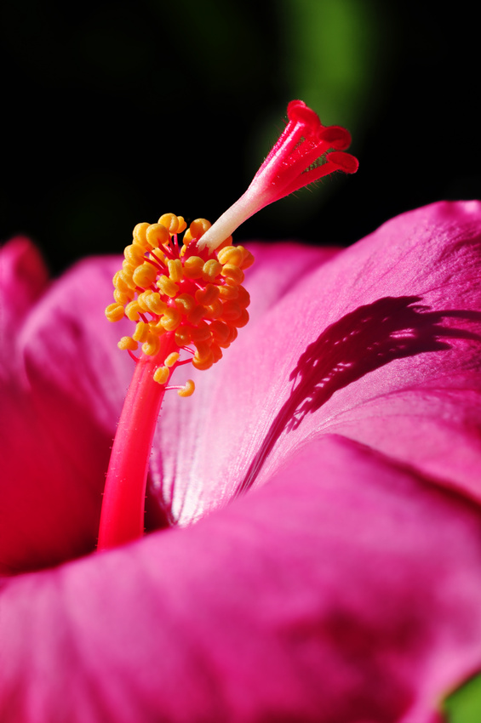
Flower
Notes:
Show results: what others see and hear; the skills developed.
Reward Status

Slide 18
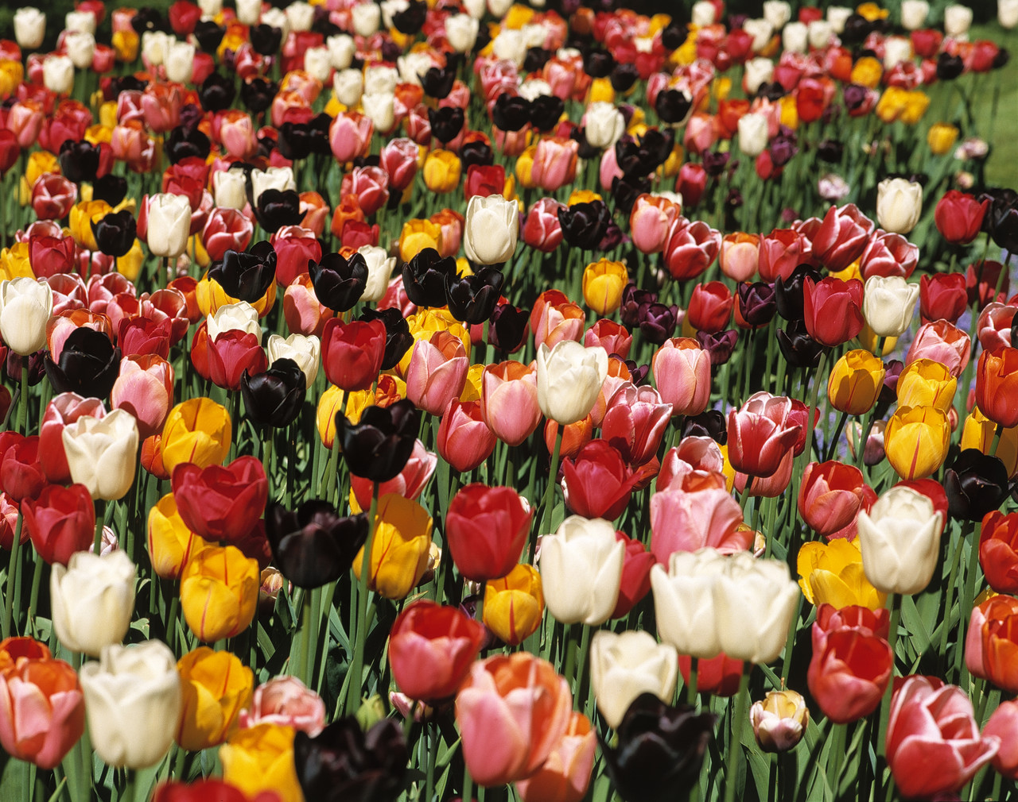
Garden
Notes:
Bringing it altogether; impact students
Variation of sizes; but same instruction: oneness

Slide 19
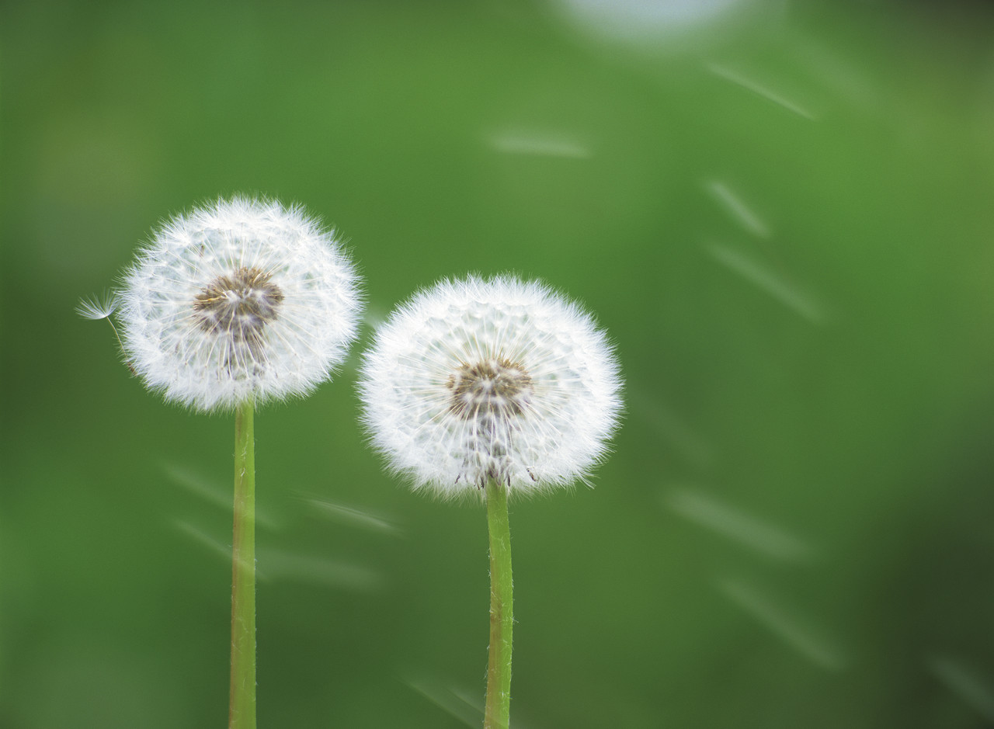
Notes:
How the information is disseminated among students, staff, community, and parents

Slide 20
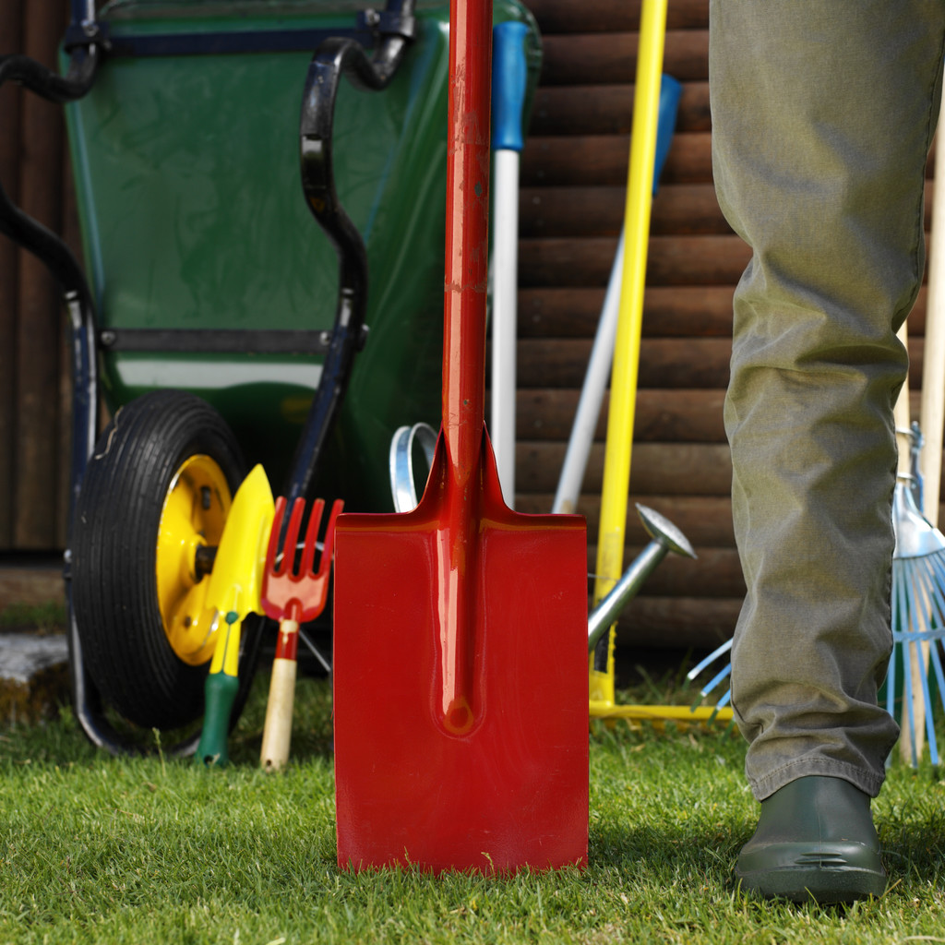
Tools
Notes:
Mrs. Chen-Kelley presents
What tools (as the media specialist) to cultivate the STEM environment.

